Slide 1

How to write Pseudocode and draw Flowchart
Behram Khan

Slide 2
Key Pseudocode Statements
1. SEQUENCE
Represents tasks that execute one after another.
2. WHILE Loop
Repeats a set of instructions while a condition is true.
3. FOR Loop
Iterates over a set range or collection.
4. IF-THEN-ELSE
Executes actions based on a condition.

Slide 3
Key Pseudocode Statements
5. CALL
Invokes a class or function.

Slide 4
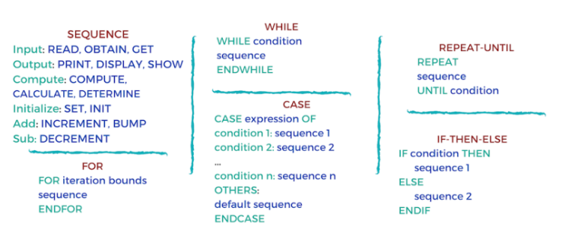
Key Pseudocode Statements

Slide 5
Common Pseudocode Commands
Print – Display output.
Calculate – Perform calculations.
Read/Input – Take user input.
Add/Subtract – Perform arithmetic operations.
Display – Show results.

Slide 6
Guidelines for Writing Pseudocode
Capitalize initial keywords.
Use one statement per line.
Indent to show structure and hierarchy.
End multi-line structures with appropriate END keywords (ENDIF, ENDWHILE, etc.).
Avoid specific programming language syntax; use plain language.
Aim for simplicity, conciseness, and readability.

Slide 7
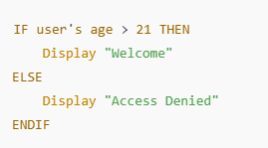
Example of IF-THEN-ELSE
The IF-THEN-ELSE structure allows branching based on conditions with two possible outcomes.

Slide 8
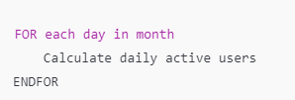
Example of FOR Loop
The FOR loop iterates over a collection or range.

Slide 9

Example of WHILE Loop
The WHILE loop repeats actions while a condition remains true.

Slide 10
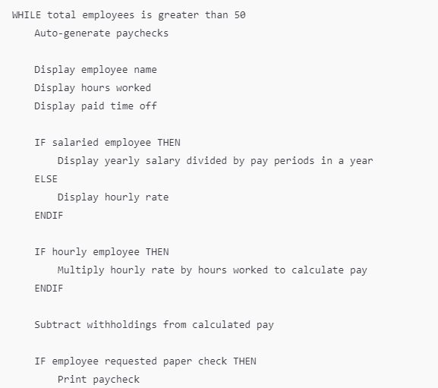
Example of pseudocode for an algorithm that generates paychecks:

Slide 11
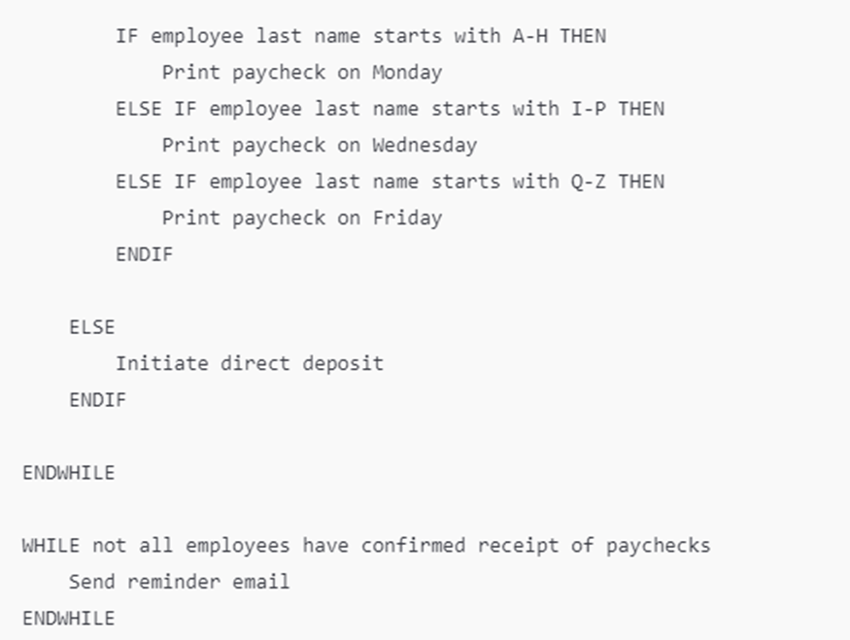
Example of pseudocode for an algorithm that generates paychecks:

Slide 12
Explanation of Each Section
1.Outer WHILE Loop for Paycheck Generation:
This loop runs while the number of total employees is greater than 50. Inside this loop, paychecks are generated, and each employee’s pay information is displayed.
2.Display Employee Information:
Displays details like the employee’s name, hours worked, and paid time off.
3.Conditional Check for Salaried or Hourly Employee:
If the employee is salaried, it calculates their pay as yearly salary divided by the number of pay periods in a year.
If not salaried, the hourly rate is displayed.

Slide 13
Explanation of Each Section
4. Hourly Employee Pay Calculation:
If the employee is hourly, it calculates pay by multiplying the hourly rate by hours worked.
5. Withholdings Subtraction:
Withholdings (like taxes or other deductions) are subtracted from the gross pay.
6. Paper Check Request and Printing:
If an employee has requested a paper check, the paycheck is printed.
Based on the employee's last name, the check is printed on a designated day:
Last names A-H: Monday
Last names I-P: Wednesday
Last names Q-Z: Friday

Slide 14
Explanation of Each Section
7. Direct Deposit Option:
If the employee did not request a paper check, direct deposit is initiated.
8. Final WHILE Loop for Confirmation:
A loop runs to send reminder emails until all employees have confirmed receipt of their paychecks.

Slide 15
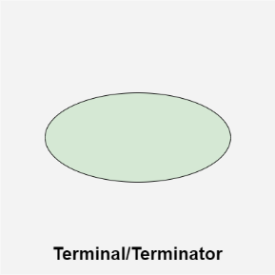
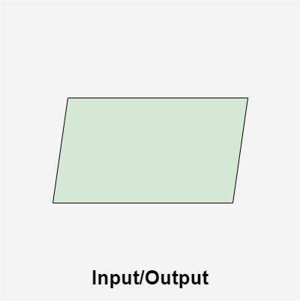
Flowchart: Symbols used in Flowchart Designs
Terminal/Terminator
The oval symbol indicates Start, Stop a program. Terminal is the first and last symbols in the flowchart.
2. Input/Output
A parallelogram denotes any function of input/output type. Program instructions that take input from input devices and display output on output devices are indicated with parallelogram in a flowchart.

Slide 16
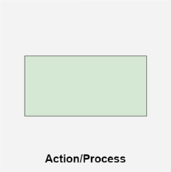
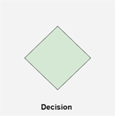
Flowchart: Symbols used in Flowchart Designs
3. Action/Process
A box represents arithmetic instructions, specific action or operation that occurs as a part of the process. All arithmetic processes such as adding, subtracting, multiplication and division are indicated by action/process symbol.
4. Decision
Diamond symbol represents a decision point. Decision based operations such as yes/no question or true/false are indicated by diamond in flowchart.

Slide 17
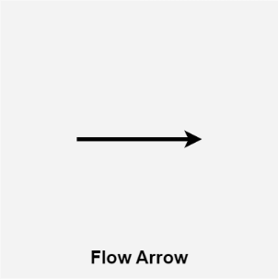
Flowchart: Symbols used in Flowchart Designs
5. Flow lines
Flow lines indicate the exact sequence in which instructions are executed. Arrows represent the direction of flow of control and relationship among different symbols of flowchart.

Slide 18
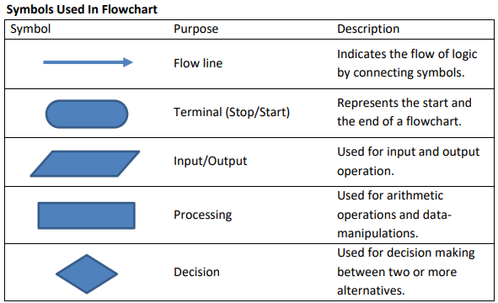
Flowchart: Symbols used in Flowchart Designs

Slide 19
Rules For Creating a Flowchart
A flowchart is a graphical representation of an algorithm. It should follow some rules while creating a flowchart
Rule 1: Flowchart opening statement must be ‘start’ keyword.
Rule 2: Flowchart ending statement must be ‘end’ keyword.
Rule 3: All symbols in the flowchart must be connected with an arrow line.
Rule 4: Each decision point should have two or more distinct outcomes.
Rule 5: Flow should generally move from top to bottom or left to right.

Slide 20
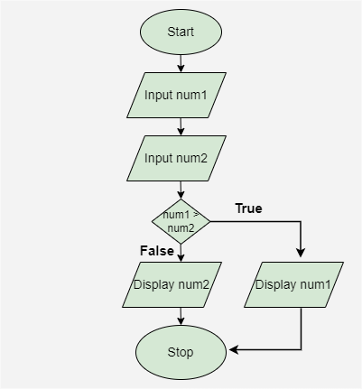
Example of a Flowchart
Draw a flowchart to input two numbers from the user and display the largest of two numbers.

Slide 21
Example of a Flowchart
Start: The process begins with the Start symbol, indicating the start of the program.
Input num1: The first number, represented as num1, is entered.
Input num2: The second number, represented as num2, is entered.
Decision (num1 > num2): A decision point checks if num1 is greater than num2.
If True, the process moves to the next step where num1 will be displayed.
If False, the process moves to display num2.
Stop: The process ends with the Stop symbol, signaling the conclusion of the program.

